Slide 1
Organized Personal Planner for Success
OPPS
Big Data
“A Bullet Journal for the Digital Age”

Slide 2

Who are we?
Startup Company
App Developers
Everyday people with busy schedules!
Experienced in various fields:
Marketing
UI/UX development
Project management
Documentation team
Leadership

Slide 3

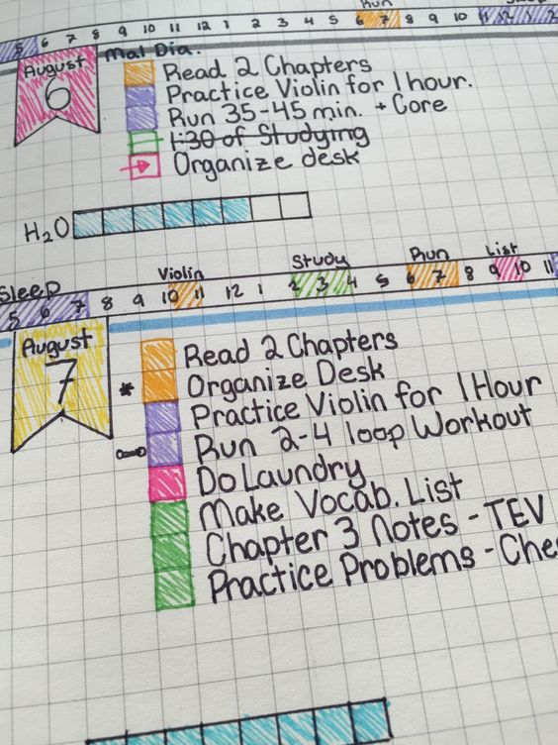
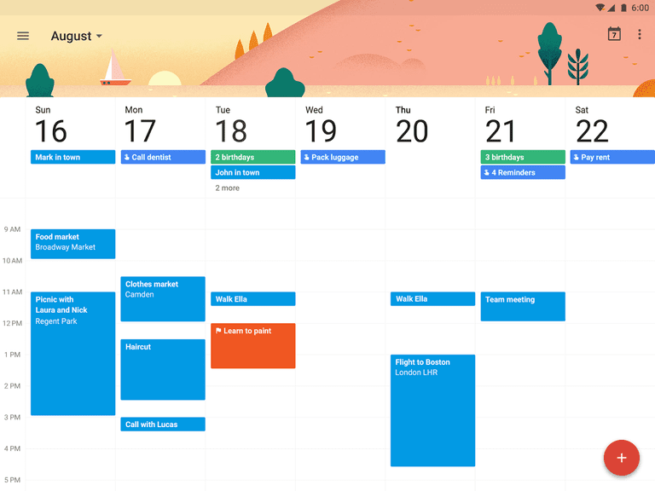


Pitch
We are combining the features and benefits of a Bullet Journal, and the features and benefits of the leading electronic calendars, with the addition of key real-time data leveraging API's to bring a new and exciting solution to the market.

Slide 4
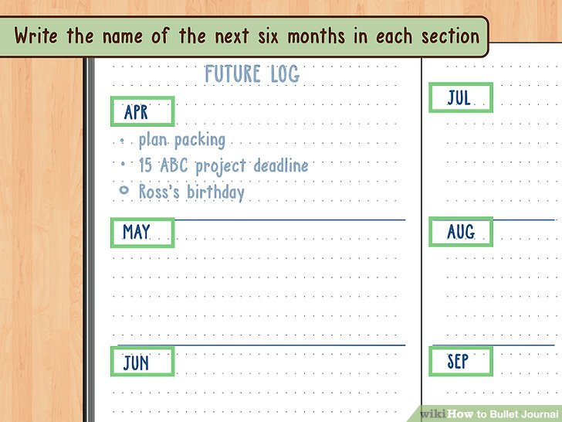
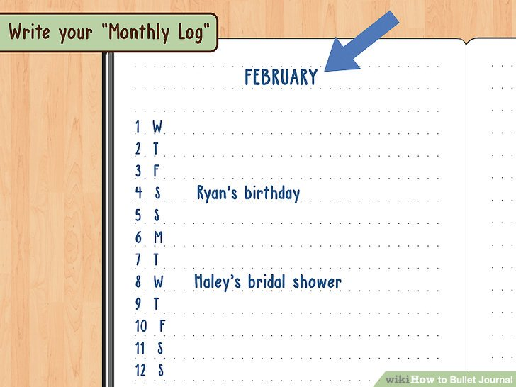
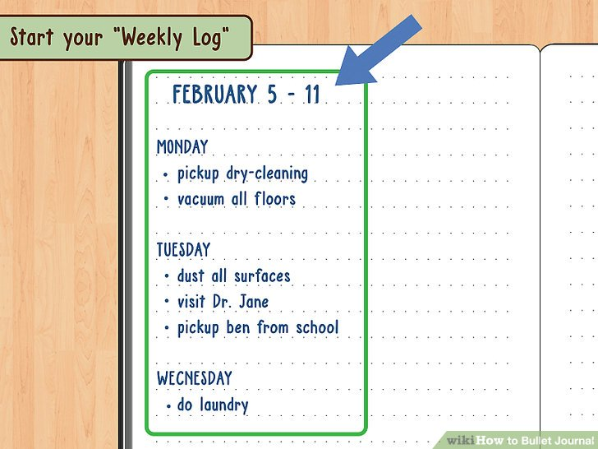
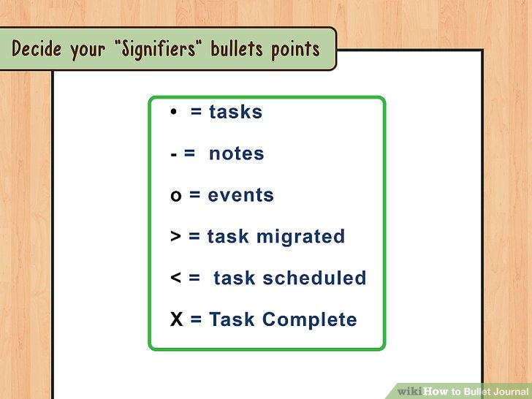
Bullet Journal Basics
Images are Creative Commons Licensed retrieved from WikiHow

Slide 5
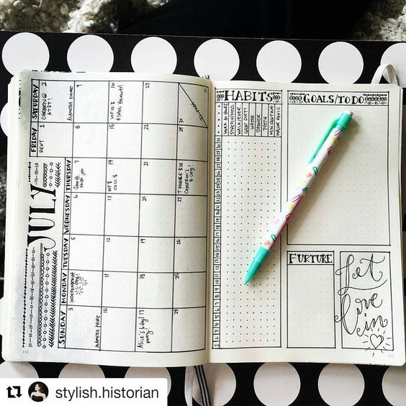
Customize
Images are Creative Commons Licensed retrieved from Google Images

Slide 6


Problem + Gaps
What’s the Issue?
Waste a lot of time before actually accomplishing goals
You forget to check planners
Not ideal for those who need to maximize their time
Planners are manual and static without real-time updates
So What?
OPPS is designed to promote efficiency
Help our customers manage and optimize:
Time
Tasks
Organization.
OPPS can connect employees, students and business owners simultaneously with their ever-changing schedule
Project Need
People often do not take the time to write everything down.
The primary goal is to complete tasks written in planners
We want to create a seamless integration between user platforms and their calendars to promote overall improvement in the quality of life.
Notes:
Problem Statement/Idea – The Elevator Pitch:
What is the problem we are solving?
What is the gap/need/want we are filling/meeting?
What is the “so what” of why we are doing what we are doing?
"Shark Tank - Fizzics" pitch which we will discuss in class:

Slide 7
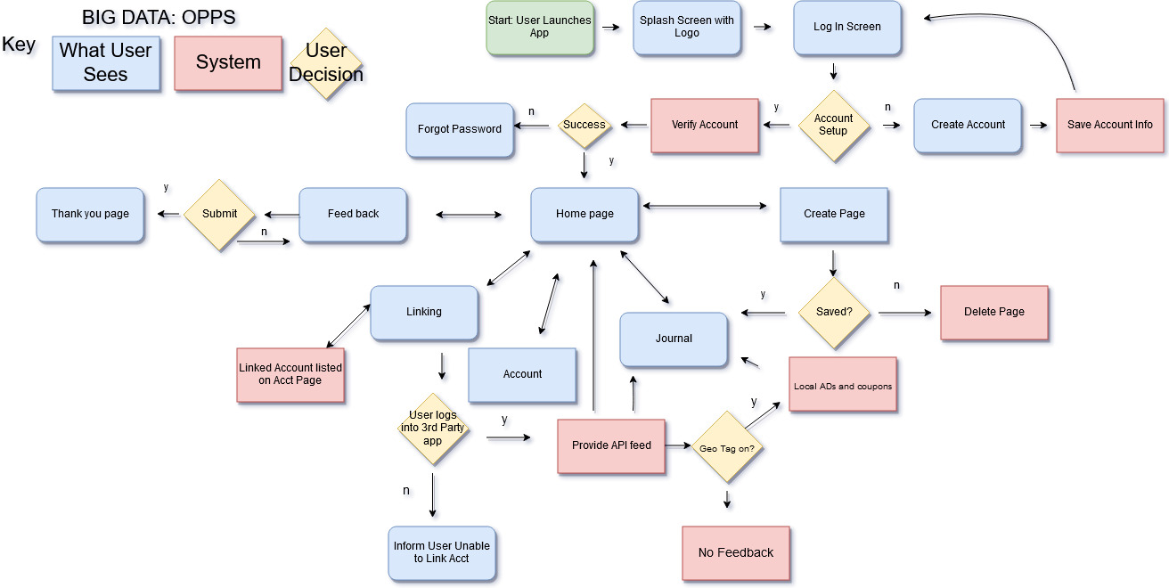
Solution Flow Diagram

Slide 8
High Fidelity
Link
https://indigodesigned.com/share/uabqycykjxu1

Slide 9
Stakeholders
Application Program Interface (API) Providers
Google
Uber
Facebook
Groupme
Etc.
Others
Other Planner Apps
Kickstarter
Investors
Employees

Slide 10


Customers &
Target Audience
Men and Women Ages of 18-30
Average age of 25
Young adults both:
Organized
Unorganized
People with:
Routines that could use some better time management
No skill set to manage their routine’s
People looking to maximize their time
Get the most out of their day
Notes:
Customers/Target Audience:
Who will benefit from our project?
Who wants to “buy” our project?
Who will care if our project doesn’t happen?

Slide 11


Full Scope
Audience Definition
People ages: 18-30 expected average age: 25
Region
North America,
Specifically the East-Coast
Hardware
Smartphones
Tablets
Supported Operating Systems
iOS/ Android
OS Supported:
iOS 11 and Android 8.0 Oreo and forward releases.

Slide 12

Market Research Summary
Sent out 300 surveys with a response rate of 33% for our Google Survey Plan
Who are we surveying, and why?
Adults from the age of 18 - 30
This age group tends to be quicker to adopt technologies and push new trends
Addressed the common issues with paper markets

Slide 13
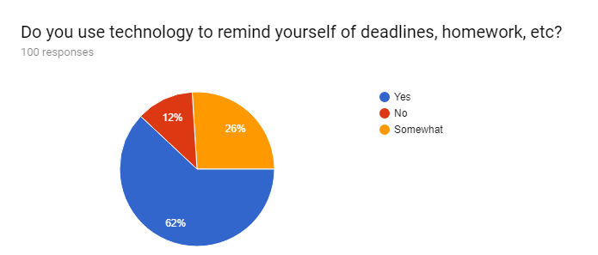
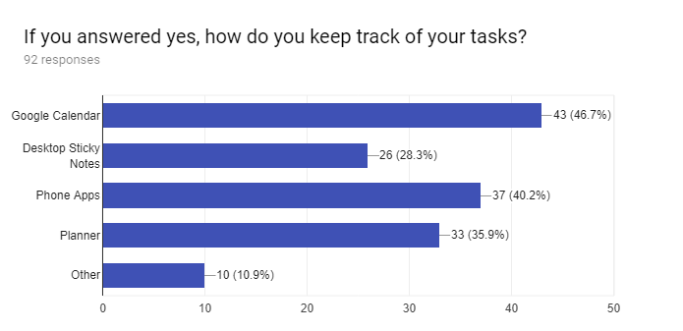
Market Research
67% of people use technology to remind them of tasks
47% use Google Calendar
37% use Planner Apps on their Phone
37% use paper planners

Slide 14
SWOT Analysis
Strengths Can give users different experiences. Tools can be used in different ways Building off API that already exist to improve user experience | Weaknesses People not knowing what a bullet journal is. API not giving correct information Relying on different API rather their are own tracking.
Opportunities This is something different, unique, and customizable Covers a lot of different API and we can read that data to cater to our audience. Focus on education, artist, business industries. | Threats Online Planners Companies blocking our application. People try to break the app Adblocker
SWOT Analysis
Notes:
S1. Experiences 2. Versatile 3. Building off API that exist already
W1. Unfamiliar 2. Incorrect Feedback 3. API difficulties
O1. Unique and Original 2. Wide Coverage of data being displayed. 3.
T1. Competition 2. Inconsistency 3. Adblocker

Slide 15
OPPS Magic Quadrant
Challengers
Leaders
OPPS has the greatest vision and the best features integrated
Uses data collection on a large scale to improve time management
Microsoft is a leader and our greatest threat. The have money and teams to back a better design.
Lemone is leading for paperback bullet journals, if they wanted to start a mobile app, they would be another huge threat.
Bullet Journal Companion is a project done by a solo programmer and has no big data features implemented.
Microsoft OneNote
Ability to Execute
Lemome
Creative Notebooks
Trello
Bullet Journal Companion
Peter Pauper Press
Book Factory
OPPS
Panda Planners
Niche Players
Visionaries
Completeness of vision

Slide 16


Challenges
What other solutions and technologies already exist?
Many people use Google’s Gmail Planner or Outlook to plan their needs
What does the research tell us from quantifiable data?
Through primary and secondary research we have established the necessity for our application in order to fill a gap between technology and planners.

Slide 17
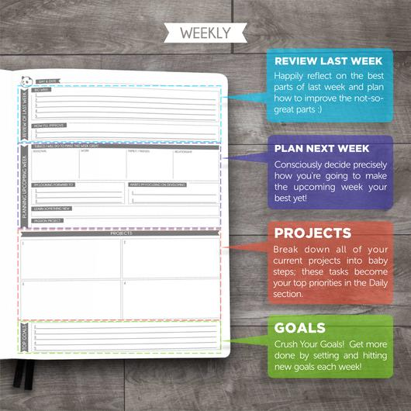
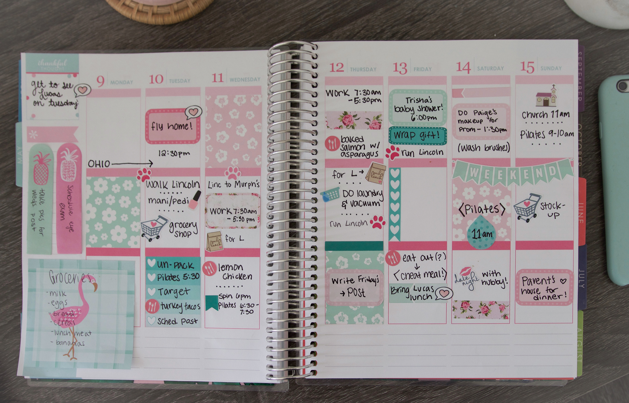
Paper Market
Challenges
Panda Planner
“Scientifically proven to make the user happier and more productive through positive psychology”
Erin Condren Life Planner
Attractive Design and Customizable
“A new wave for stylish organization”

Slide 18
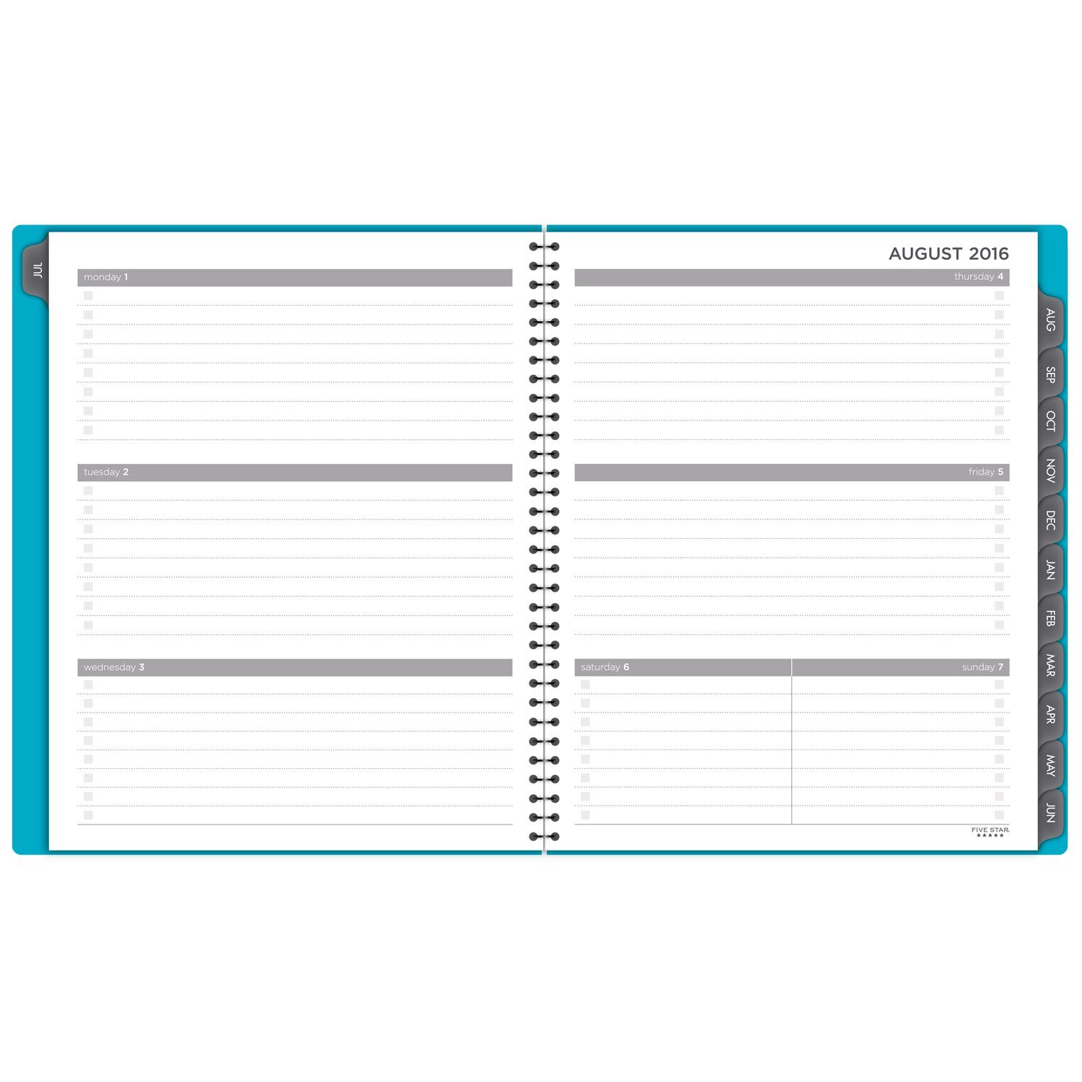
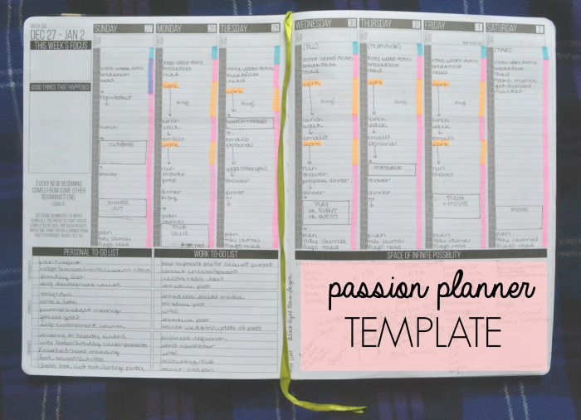
Paper Market cont...
Five Star Academic Planner
Student geared design for a simple and adult style
Passion Planner
Motivational based on the primary idea of setting and reaching goals

Slide 19

Ethics, Privacy, and Security
Concerns:
-The Cloud
-Access Control
-Size/Amount of information collected and shared
Resolution:
-Encryption
-Secure login/ agreement with other apps to secure info.
-Limitations of tasks per week/month
-Anonymise data
Notes:
Login with username and password
(with concerns to outside apps)
(Facebook controversy)
(make sure users are not automatically opted into sharing data)
(since this app is designed for peoples personal schedules, the username should not give away their full identity)

Slide 20
Ethics, Privacy, and Security
Cont...
Concerns:
Data Breach of personal information
Malicious use of personal data
Exploits in-app bugs that leave user information exposed
High usage of personal data for advertisement purposes
Resolutions:
High level of user discretion when handling data
Transparency in the way user data is being collected and used
Limit access to user data by third-party application
Updated application ensuring bugs are patched

Slide 21
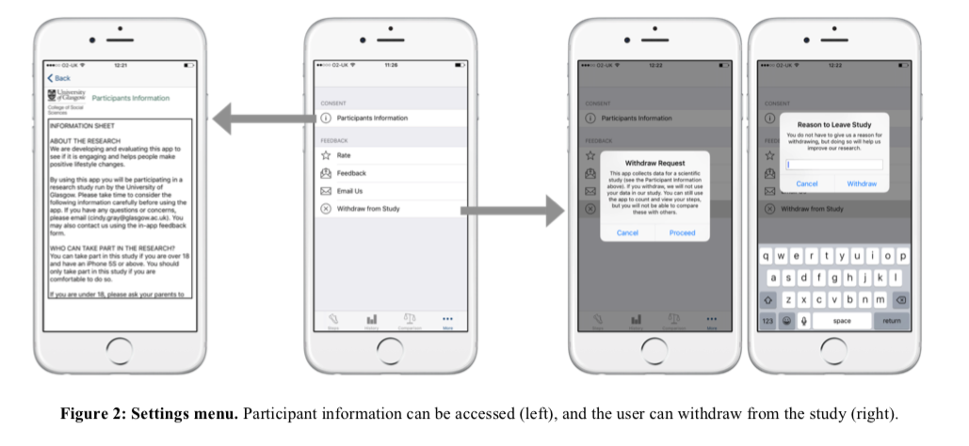
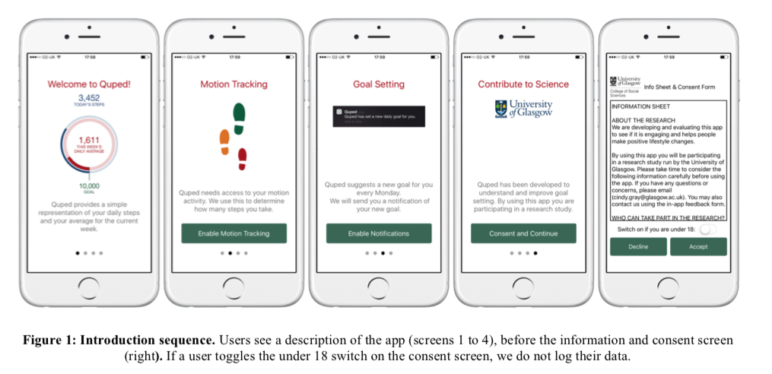
Ethics, Privacy, and Security
Cont...
Concerns:
-The work environment
-Data management
Example of Addressing Privacy Concerns:
Retrieved From:
Rooksby, J., Asadzadeh, P., Morrison, A., McCallum, C., Gray, C., & Chalmers, M. (2016, December 2). Implementing Ethics for a Mobile App Deployment. Computing Science Institute of Health and Wellbeing University of Glasgow, UK, 1-10. doi:http://dx.doi.org/10.1145/3010915.3010919

Slide 22
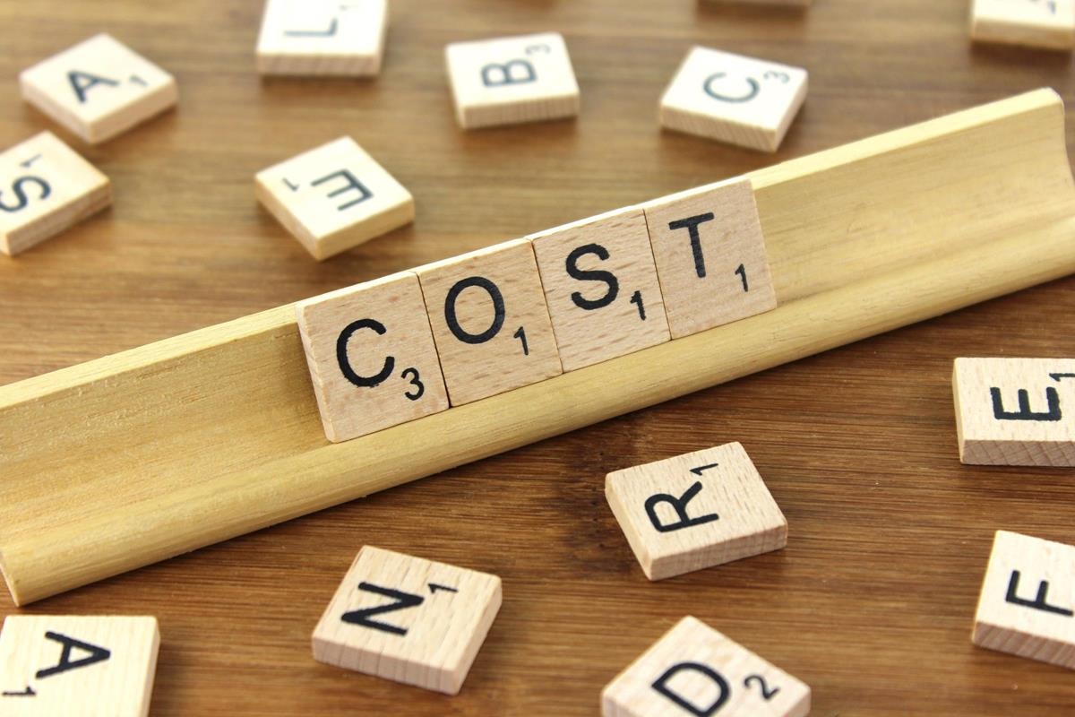

Project Financials
Cloud storage facilities
First 50 TB / month
$0.0245 per GB
Next 450 TB/month
$0.0235 per GB
Over 500 TB/month
$0.0225 per GB
iPhones - $500 each
Android phones - $400 each
Computers - 9 devices
$850/each
Software Licenses per device
Microsoft - $883
Adobe - $30/month
Norton Antivirus - $40/year
Labor cost:
4 Programmers: $79,530 * 4
Manager: $100,000
Customer Support: $60,000
Legal: $48,810
Financial: $65,000
HR: $51,000
Market and Sales: $40,000

Slide 23

Project Financials
Benefits
Coupons have proven themselves to be highly effective sales tools. CMO Council reports that 71% of internet users in the U.S. were influenced by coupons and discounts when making their purchase decisions. ($10k-$20k/year)
The expected consumers will be 100,000 which could lead to $200,000 profit for the first year, and then the number will be doubled for the next years for the premier feature.
Advertisement: The average Cost Per Click (CPC) is about $0.35 globally and about $0.28 in the U.S.
The privacy premium will be added to the users such hiding the content even from your friends that will increase our usage on the platform to 20% for the first year.
The net revenue for our start up company will be $13,905,923 at the end of our 5th year.

Slide 24
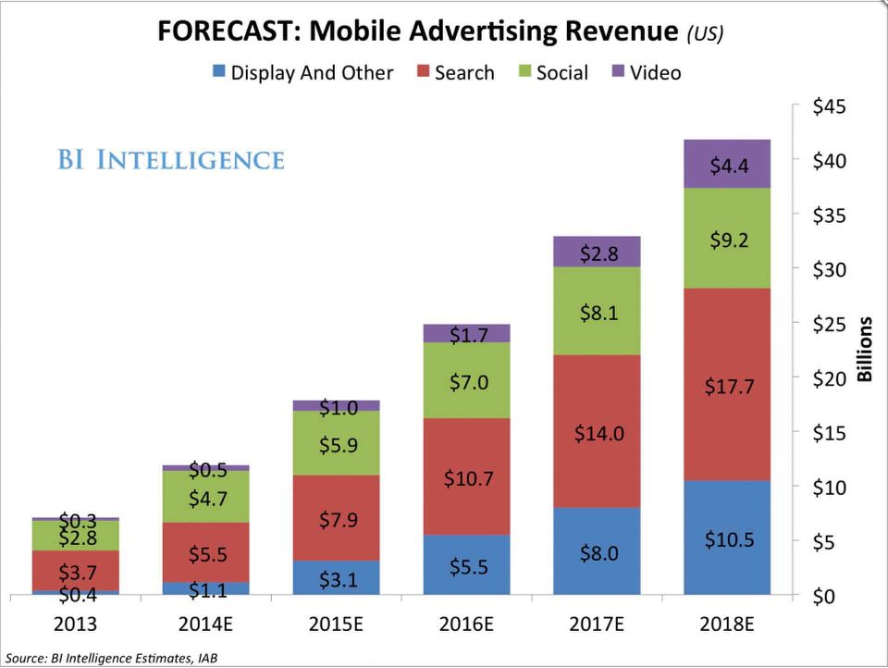
Project Financials: Graphs
http://www.businessofapps.com/data/app-revenues/

Slide 25
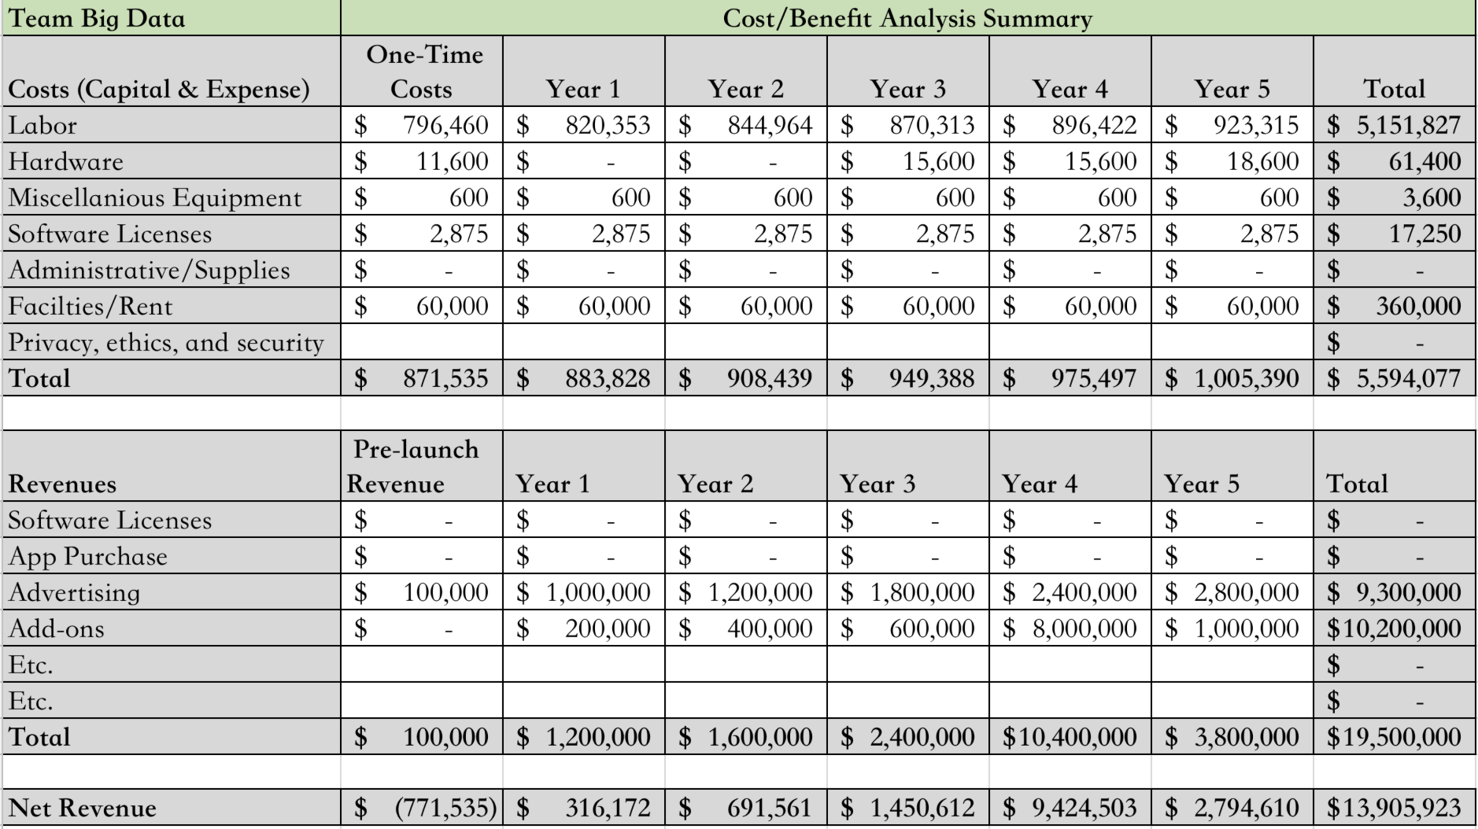
Cost spreadsheet

Slide 26
Lessons Learned
Time management is a very important skill to have during group projects
Being able to communicate appropriately is important as well
Although there were individual roles, maintaining a team through hardships is crucial
Supporting/encouraging one another increases motivation
Deadlines are not only important to have but also to maintain in order to keep everything running smoothly
Mistakes are fine as long as a lesson was learned and improved upon
How To Manage the Financials and reorganizing it
I learned how to collaborate with the team and making sure I am on time with them
Making the workflow diagram before the high fidelity made planning and designing incredibly easier.

Slide 27
Appendices
Fu, B., Lin, J., Li, L., Faloutsos, C., Hong, J., & Sadeh, N. (2013, August). Why people hate your app: Making sense of user feedback in a mobile app store. In Proceedings of the 19th ACM SIGKDD international conference on Knowledge discovery and data mining (pp. 1276-1284). ACM.
HOW Mac Experts Manage Their Calendars. (2014). Macworld, 31(5), 70-72.
Most popular smartphone OS in the U.S. 2017 | Statistic. (n.d.). Retrieved February 12, 2018, from https://www.statista.com/statistics/716053/most-popular-smartphone-operating-systems-in-us/
Santos, W. (2017, September 01). Which Are Developers Favorite APIs? Retrieved February 10, 2018, from https://www.programmableweb.com/news/which-are-developers-favorite-apis/research/2017/09/01
WANG, K., & GOLDFARB, A. (2017). Can Offline Stores Drive Online Sales?. Journal Of Marketing Research (JMR), 54(5), 706-719 .
http://bulletjournal.com/how-effective-is-bullet-journaling-for-project-managers/
https://blog.formotus.com/enterprise-mobility/figuring-the-costs-of-custom-mobile-business-app-development
https://www.otreva.com/calculator/
http://calculator.kinvey.com/mbaas-savings-calculator
http://advantage.marketline.com.proxy.libraries.rutgers.edu/Product?ptype=Companies&pid=679613FB-9911-4907-8C86-9902F9D5BEF4
https://www.forbes.com/sites/greatspeculations/2017/10/30/facebooks-strong-ad-revenue-growth-to-continue/#79bd0c8c6fe7
Notes:
What is the data that supports our project idea?
Email, Geolocation, social media events
Why does the business/market want this?
The market become indeed of a new social platform that gather all in once and arrange their daily lives. Most of companies like facebook or twitter don't have bullet journal as we see it’s a generation lifestyle.
How many people/businesses of what type? How do we know?
Students with many courses; 2. a system of organization to capture, process and execute on their daily tasks and incoming information; 3. Project manager
What other solutions and technologies already exist?
Smartphone calendar, Google calendar
What does the research tell us from quantifiable data?
85% of PMs are using their Bullet Journal all the time or sometimes specifically for project management activities at work. And, further, 77% of PMs state that using a Bullet Journal on the job makes their work significantly easier or easier. More than 40% use the Monthly Log and Daily Log together. Another third of the PMs work with the Index and Daily Log as their go-to modules

Slide 28
Appendices
https://www.quora.com/How-much-do-terms-and-conditions-and-privacy-statements-cost-to-get-made-for-most-startups
https://www.lexoo.co.uk/?utm_campaign=How+much+do+terms+and+conditions+and+privacy+statements+cost+to+get+made+for+most+startups%3F&utm_medium=answer&utm_source=quora
https://perryvisa.com/webPages/legalDefine.php
https://www.lexoo.co.uk/?utm_campaign=How+much+do+terms+and+conditions+and+privacy+statements+cost+to+get+made+for+most+startups%3F&utm_medium=answer&utm_source=quora
https://www.iubenda.com/en/pricing
http://www.businessinsider.com/best-planner/#the-best-planner-overall-1
Rooksby, J., Asadzadeh, P., Morrison, A., McCallum, C., Gray, C., & Chalmers, M. (2016, December 2). Implementing Ethics for a Mobile App Deployment. Computing Science Institute of Health and Wellbeing University of Glasgow, UK, 1-10. doi:http://dx.doi.org/10.1145/3010915.3010919

Slide 29
Google Survey Questions
How old are you?
What is your gender?
Are you a student?
Do you consider yourself organized?
Do you suffer with Time Management skills?
Have you ever purchased a planner? Are you familiar with a bullet journal?
Do you use technology to remind yourself of deadlines, homework, etc?
If you answered yes, how do you keep track of your tasks?
Do you consider integrated platforms convenient or confusing?
Do you find the ability to personalize/organize data attractive?
If you had the ability to organize your tasks creatively, would you be more likely to accomplish them efficiently?

Slide 30
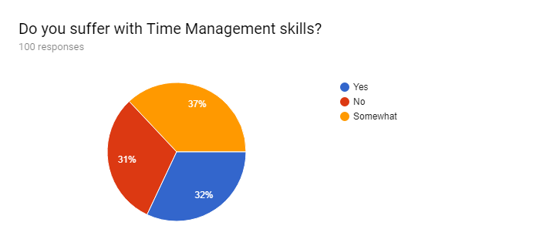
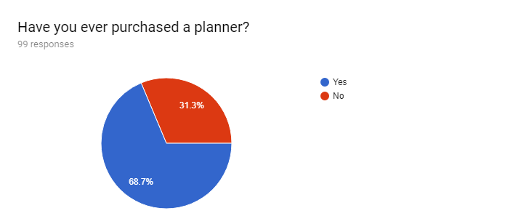
Market Research
69% of people suffer with Time Management Skills
69% of people have purchased a planner before

Slide 31
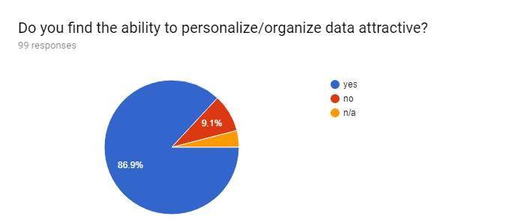
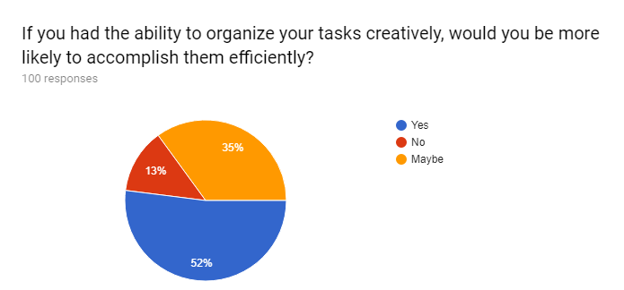
Market Research
87% of people personalizing data is attractive
52% of people would accomplish more tasks efficiently with personalization

Slide 32
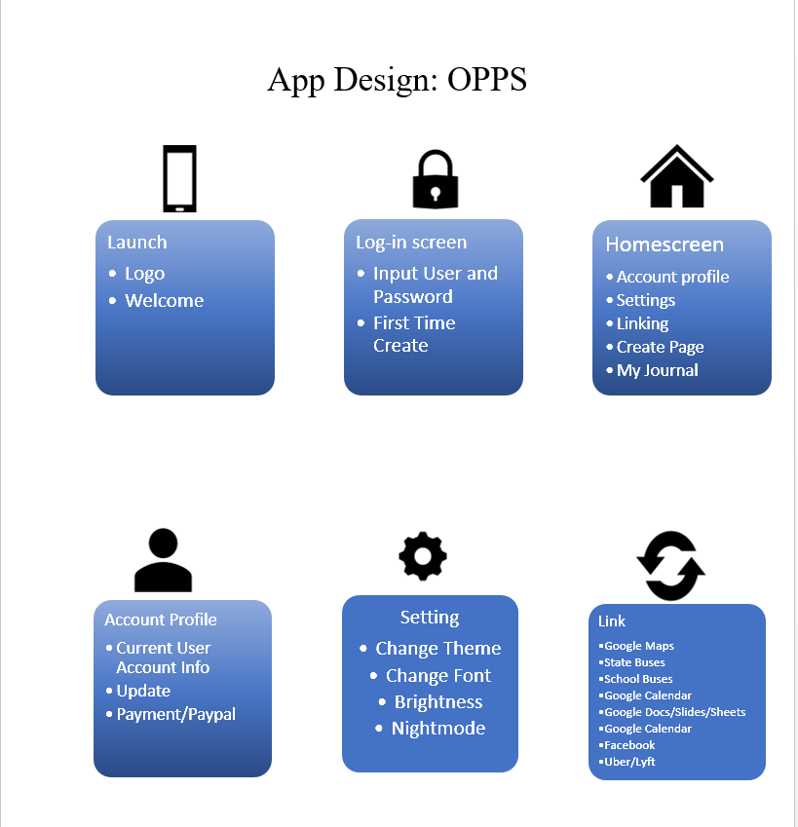
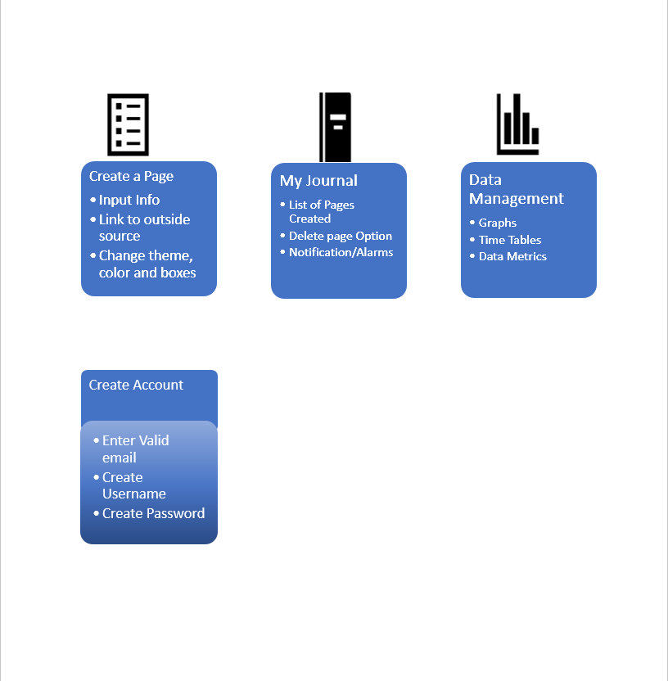
Draft UI/UX Designs

Slide 33
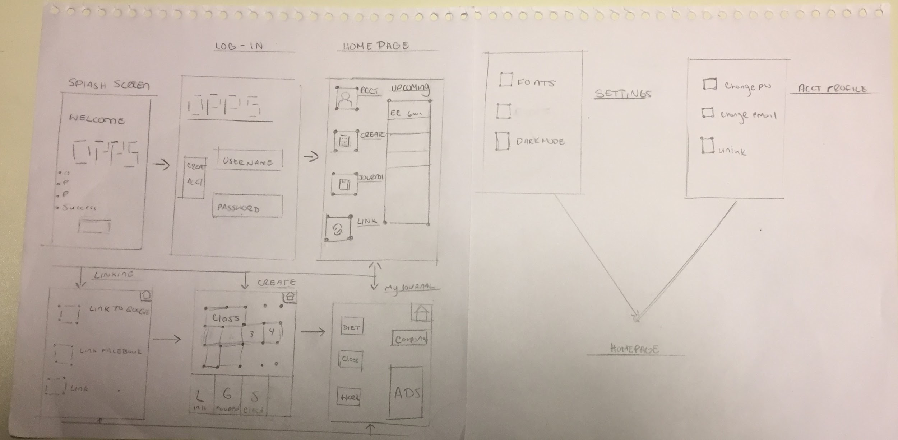
Low Fidelity

Slide 34
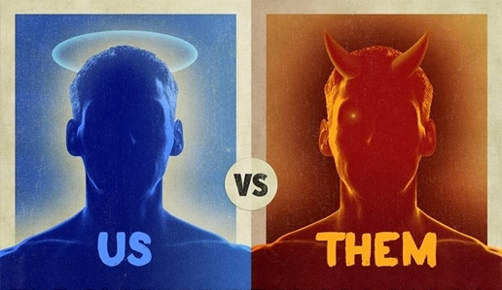
Summary
Other Apps fail to:
incorporate other platforms such as Google, Facebook, Uber, GroupMe
provide customizability
We want to:
Bridge gap between platforms and other resources for seamless integration

Slide 35
Conclusion
Thank You!
Questions, Comments, Concerns?

